Slide 1
An Overview of Computer and Microprocessor
Unit 1

Slide 2

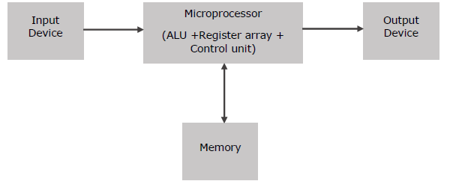
Microprocessor is a controlling unit of a micro-computer, fabricated on a small chip capable of performing ALU (Arithmetic Logical Unit) operations and communicating with the other devices connected to it.
Microprocessor consists of an ALU, register array, and a control unit. ALU performs arithmetical and logical operations on the data received from the memory or an input device.
Register array consists of registers identified by letters like B, C, D, E, H, L and accumulator.
The control unit controls the flow of data and instructions within the computer.
Block Diagram of a Basic Microcomputer

Slide 3
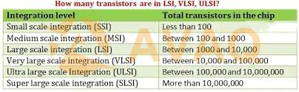

Slide 4
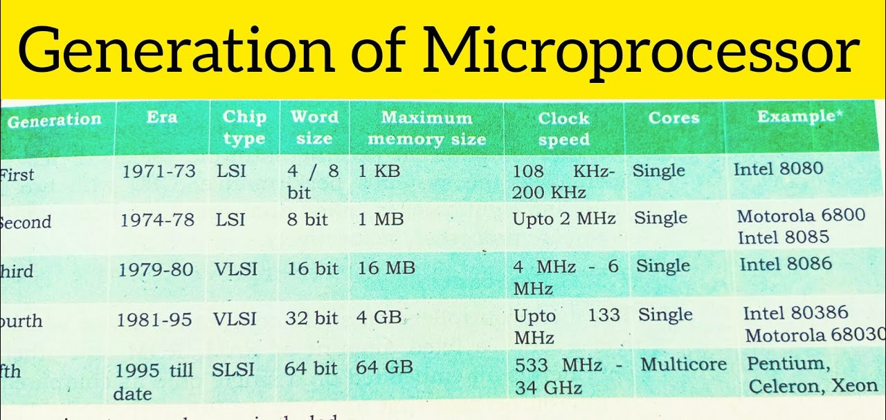

Slide 5
How does a Microprocessor Work?
The microprocessor follows a sequence: Fetch, Decode, and then Execute.
Initially, the instructions are stored in the memory in a sequential order.
The microprocessor fetches those instructions from the memory, then decodes it and executes those instructions till STOP instruction is reached.
Later, it sends the result in binary to the output port.
Between these processes, the register stores the temporarily data and ALU performs the computing functions.

Slide 6
List of Terms Used in a Microprocessor
Instruction Set − It is the set of instructions that the microprocessor can understand.
Bandwidth − It is the number of bits processed in a single instruction.
Clock Speed − It determines the number of operations per second the processor can perform. It is expressed in megahertz (MHz) or gigahertz (GHz).It is also known as Clock Rate.
Word Length − It depends upon the width of internal data bus, registers, ALU, etc. An 8-bit microprocessor can process 8-bit data at a time. The word length ranges from 4 bits to 64 bits depending upon the type of the microcomputer.
Data Types − The microprocessor has multiple data type formats like binary, BCD, ASCII, signed and unsigned numbers.

Slide 7
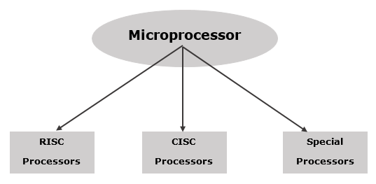
RISC Processor
RISC stands for Reduced Instruction Set Computer.
It is designed to reduce the execution time by simplifying the instruction set of the computer.
Using RISC processors, each instruction requires only one clock cycle to execute results in uniform execution time.
This reduces the efficiency as there are more lines of code, hence more RAM is needed to store the instructions.
A microprocessor can be classified into three categories

Slide 8
CISC Processor
CISC stands for Complex Instruction Set Computer.
It is designed to minimize the number of instructions per program, ignoring the number of cycles per instruction.
The emphasis is on building complex instructions directly into the hardware.
The compiler has to do very little work to translate a high-level language into assembly level language/machine code because the length of the code is relatively short, so very little RAM is required to store the instructions.
Special Processors
These are the processors which are designed for some special purposes. Few of the special processors are briefly discussed −
Coprocessor
A coprocessor is a specially designed microprocessor, which can handle its particular function many times faster than the ordinary microprocessor.
For example − Math Coprocessor.

Slide 9
Input/Output Processor
It is a specially designed microprocessor having a local memory of its own, which is used to control I/O devices with minimum CPU involvement.
Transputer (Transistor Computer)
A transputer is a specially designed microprocessor with its own local memory and having links to connect one transputer to another transputer for inter-processor communications.
It was first designed in 1980 by Inmos and is targeted to the utilization of VLSI technology.

Slide 10
Microcontroller
A microcontroller is a compact integrated circuit designed to govern a specific operation in an embedded system.
A typical microcontroller includes a processor, memory and input/output (I/O) peripherals on a single chip.
Sometimes referred to as an embedded controller or microcontroller unit (MCU), microcontrollers are found in vehicles, robots, office machines, medical devices, mobile radio transceivers, vending machines and home appliances, among other devices.

Slide 11
How do microcontrollers work?
A microcontroller is embedded inside of a system to control a singular function in a device.
It does this by interpreting data it receives from its I/O peripherals using its central processor.
The temporary information that the microcontroller receives is stored in its data memory, where the processor accesses it and uses instructions stored in its program memory to decipher and apply the incoming data.
It then uses its I/O peripherals to communicate and enact the appropriate action.

Slide 12
What are the elements of a microcontroller?
The core elements of a microcontroller are:
The processor (CPU) -- A processor can be thought of as the brain of the device. It processes and responds to various instructions that direct the microcontroller's function.
This involves performing basic arithmetic, logic and I/O operations.
It also performs data transfer operations, which communicate commands to other components in the larger embedded system.
Memory -- A microcontroller's memory is used to store the data that the processor receives and uses to respond to instructions that it's been programmed to carry out.
A microcontroller has two main memory types:
Program memory, which stores long-term information about the instructions that the CPU carries out.
Data memory, which is required for temporary data storage while the instructions are being executed.

Slide 13
I/O peripherals -- The input and output devices are the interface for the processor to the outside world.
The input ports receive information and send it to the processor in the form of binary data.
The processor receives that data and sends the necessary instructions to output devices that execute tasks external to the microcontroller.

Slide 14
Other supporting elements of a microcontroller include:
Analog to Digital Converter (ADC) -- An ADC is a circuit that converts analog signals to digital signals.
It allows the processor at the center of the microcontroller to interface with external analog devices, such as sensors.
Digital to Analog Converter (DAC) -- A DAC performs the inverse function of an ADC and allows the processor at the center of the microcontroller to communicate its outgoing signals to external analog components.
System bus -- The system bus is the connective wire that links all components of the microcontroller together.
Serial port -- The serial port is one example of an I/O port that allows the microcontroller to connect to external components.
It has a similar function to a USB or a parallel port but differs in the way it exchanges bits.

Slide 15
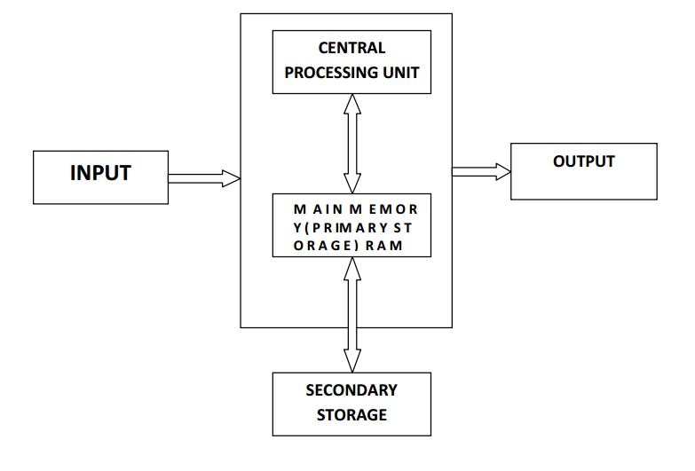
Organization of a Computer System
The basic organization of a computer system is the processing unit, memory unit, and input-output devices.
The processing unit controls all the functions of the computer system.
It is the brain of the computer e.g. CPU.
The CPU consists of two units.
One is an arithmetic unit and the other is a logic unit.
Input devices are those devices through which end-users can send messages to computers e.g. keyboard, mouse, etc.
Output devices are those devices through which end-users get output from computers e.g. monitors.

Slide 16
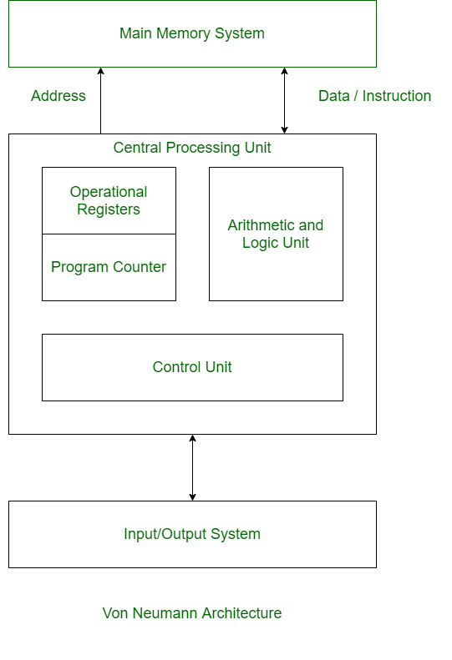
Von Neumann Architecture:
Von Neumann Architecture is a digital computer architecture whose design is based on the concept of stored program computers where program data and instruction data are stored in the same memory.
This architecture was designed by the famous mathematician and physicist John Von Neumann in 1945.

Slide 17
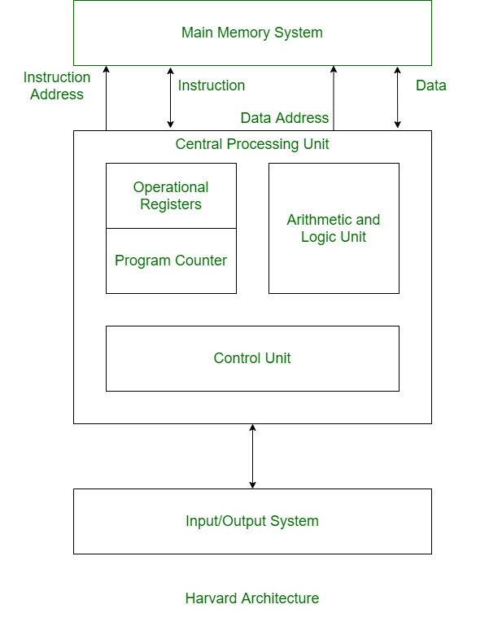
Harvard Architecture:
Harvard Architecture is the digital computer architecture whose design is based on the concept where there are separate storage and separate buses (signal path) for instruction and data.
It was basically developed to overcome the bottleneck of Von Neumann Architecture.

Slide 18
Difference between Von Neumann and Harvard Architecture :
VON NEUMANN ARCHITECTURE | HARVARD ARCHITECTURE
It is ancient computer architecture based on stored program computer concept. | It is modern computer architecture based on Harvard Mark I relay based model.
Same physical memory address is used for instructions and data. | Separate physical memory address is used for instructions and data.
There is common bus for data and instruction transfer. | Separate buses are used for transferring data and instruction.
Two clock cycles are required to execute single instruction. | An instruction is executed in a single cycle.
It is cheaper in cost. | It is costly than Von Neumann Architecture.
CPU can not access instructions and read/write at the same time. | CPU can access instructions and read/write at the same time.
It is used in personal computers and small computers. | It is used in micro controllers and signal processing.

Slide 19
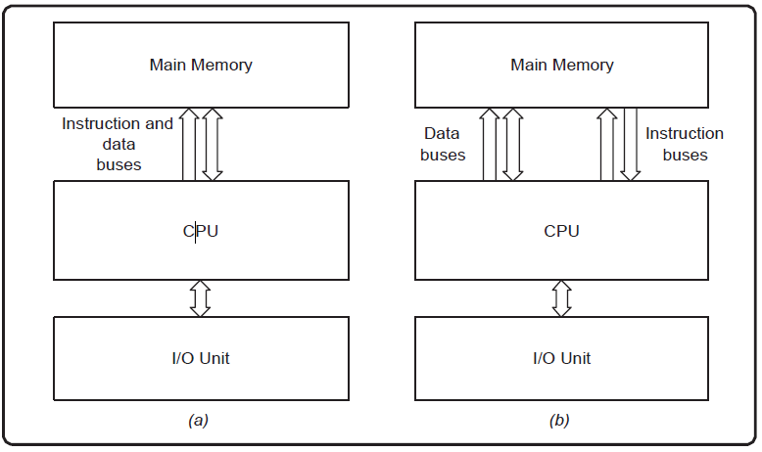
What Is Computer Architecture?
Computer architecture refers to the end-to-end structure of a computer system that determines how its components interact with each other in helping to execute the machine’s purpose (i.e., processing data), often avoiding any reference to the actual technical implementation.
Examples of Computer Architecture: Von Neumann Architecture (a) and Harvard Architecture (b)

Slide 20
Computer architecture is the arrangement of the components that comprise a computer system and the engine at the core of the processes that drive its functioning.
It specifies the machine interface for which programming languages and associated processors are designed.
Complex instruction set computer (CISC) and reduced instruction set computer (RISC) are the two predominant approaches to the architecture that influence how computer processors function.

Slide 21
Components of Computer Architecture
Depending on the method of categorization, the parts of a computer architecture can be subdivided in several ways.
The main components of a computer architecture are the CPU, memory, and peripherals.
All these elements are linked by the system bus, which comprises an address bus, a data bus, and a control bus.
Within this framework, the computer architecture has eight key components, as described below.

Slide 22
Components of Computer Architecture
1. Input unit and associated peripherals
The input unit provides external data sources to the computer system, It connects the external environment to the computer.
It receives information from input devices, translates it to machine language, and then inserts it within the computer system.
The keyboard, mouse, or other input devices are the most often utilized and have corresponding hardware drivers that allow them to work in sync with the rest of the computer architecture.

Slide 23
2. Output unit and associated peripherals
The output unit delivers the computer process’s results to the user.
A majority of the output data comprises music, graphics, or video.
A computer architecture’s output devices encompass the display, printing unit, speakers, headphones, etc.
To play an MP3 file, for instance, the system reads a number array from the disc and into memory.
The computer architecture manipulates these numbers to convert compressed audio data to uncompressed audio data and then outputs the resulting set of numbers (uncompressed audio file) to the audio chips.
The chip then makes it user-ready through the output unit and associated peripherals.

Slide 24
3. Storage unit/memory
The storage unit contains numerous computer parts that are employed to store data.
It is typically separated into primary storage and secondary storage.
RAM
ROM
Secondary storage unit
Secondary or external storage is inaccessible directly to the CPU.
Before the CPU uses secondary storage data, it must be transferred to the main storage.
Secondary storage permanently retains vast amounts of data. Examples include hard disk drives (HDDs), solid-state drives (SSDs), compact disks (CDs), etc.

Slide 25
4.Central processing unit (CPU)
The central processing unit includes registers, an arithmetic logic unit (ALU), and control circuits, which interpret and execute assembly language instructions.
The CPU interacts with all the other parts of the computer architecture to make sense of the data and deliver the necessary output.
Here is a brief overview of the CPU’s sub-component
1. Registers
2. Arithmetic logic unit (ALU)
3. Control unit

Slide 26
5. Operating system (OS):
The operating system governs the computer’s functionality just above firmware.
It manages memory usage and regulates devices such as the keyboard, mouse, display, and disc drives.
The OS also provides the user with an interface, allowing them to launch apps and access data on the drive.

Slide 27
6. Buses
A bus is a tangible collection of signal lines with a linked purpose; a good example is the universal serial bus (USB).
Buses enable the flow of electrical impulses between various components of a computer’s design, transferring information from one system to another.
The size of a bus is the count of information-transferring signal lines.
A bus with a size of 8 bits, for instance, transports 8 data bits in a parallel formation.

Slide 28
8. Interrupts
Interrupts, also known as traps or exceptions in certain processors, are a method for redirecting the processor from the running of the current program so that it can handle an occurrence.
Such an event might be a malfunction from a peripheral or just the fact that an I/O device has completed its previous duty and is presently ready for another one.
Every time you press a key and click a mouse button, your system will generate an interrupt.

Slide 29
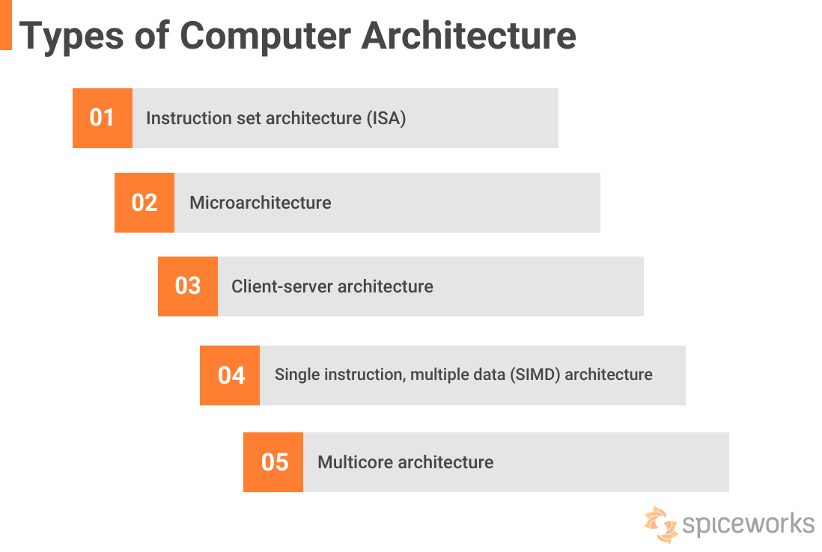

Slide 30
 | Computer Architecture | Computer Organization
1. | Architecture describes what the computer does. | The Organization describes how it does it.
2. | Computer Architecture deals with the functional behavior of computer systems. | Computer Organization deals with a structural relationship.
3. | Computer Architecture comprises logical functions such as instruction sets, registers, data types, and addressing modes. | Computer Organization consists of physical units like circuit designs, peripherals, and adders.
4. | Architecture indicates its hardware. | Whereas Organization indicates its performance.
5. | As a programmer, you can view architecture as a series of instructions, addressing modes, and registers. | The implementation of the architecture is called organization.
6. | For designing a computer, its architecture is fixed first. | For designing a computer, an organization is decided after its architecture.
7. | Computer Architecture is also called Instruction Set Architecture (ISA). | Computer Organization is frequently called microarchitecture.

Slide 31
8.
Computer Architecture comprises logical functions such as instruction sets, registers, data types, and addressing modes.
Computer Organization consists of physical units like circuit designs, peripherals, and adders.
9.
The different architectural categories found in our computer systems are as follows:
Von-Neumann Architecture
Harvard Architecture
Instruction Set Architecture
Micro-architecture
System Design
CPU organization is classified into three categories based on the number of address fields:
Organization of a single Accumulator.
Organization of general registers
Stack organization

Slide 32
10.
It makes the computer’s hardware visible.
It offers details on how well the computer performs.
11.
Architecture coordinates the hardware and software of the system.
Computer Organization handles the segments of the network in a system.
12.
The software developer is aware of it.
It escapes the software programmer’s detection.
13.
Examples- Intel and AMD created the x86 processor. Sun Microsystems and others created the SPARC processor. Apple, IBM, and Motorola created the PowerPC.
Organizational qualities include hardware elements that are invisible to the programmer, such as interfacing of computer and peripherals, memory technologies, and control signals.

Slide 33
Applications of Microprocessor and Microcontroller
The microprocessor is used in an application where the task is not predefined and it is assigned by the user.
It is used in computers, mobiles, video games, TVs, etc where the task is not fixed and it depends on the user. Generally, the microprocessor is used where intensive processing is required.
A laptop is the best example where a microprocessor is used.
The laptop is used for media streaming, simulation, editing image, web browsing, gaming, creating a document and many more

Slide 34
Microcontroller
The microcontroller is designed for a specific task and once the program is embed on MCU chip, it can’t be altered easily and you may be needed special tools to reburn it.
The process of the microcontroller is fixed according to its application. Hence, it does some processing, based on the input given to the microcontroller and gives the predefined results as an output.
The input could be given by the user or it could be given by the sensors.
It is used in many electronic appliances like washing machine, microwave oven, timer, etc.

Slide 35
In these equipment's, the process is predefined, it may need some inputs from user to give predefine output.
Let say washing machine, once the user sets the input parameters, it wash the clothes according to input parameter.
So, the basic task (washing the clothes) for the washing machine is fixed.
You cannot do anything else from the washing machine.

Slide 36
Microprocessor Applications:
Microprocessors are manufactured for general-purpose systems that can handle multiple tasks at once. The systems that handle multiple tasks at once require a variable amount of memory and storage.
Examples include personal computers (PC), gaming devices, ATM machines, robots, defense systems, smartphones, servers, railways/airport traffic controller systems, etc.
The above systems handle multiple tasks simultaneously, so microprocessors are their right fit.

Slide 37
Microcontroller Applications:
Microcontrollers are specifically fabricated for embedded systems that require limited memory and storage to do specific tasks.
They are part of devices used in digital medical equipment, sensors, measuring devices, industrial devices, hi-tech systems, etc.
Examples are Electrocardiography(EGC) machines, remotes, digital cameras, washing machines, telephones, calculators, car systems, digital thermometers, etc.
The design engineers choose microcontrollers considering the size and cost of the device. External RAM, ROM, memory, timers, ports, etc make the system expensive, and complex, and more lines of code to perform the task.
Microcontrollers keep the system simple and light.

